Slide 1
Composite Data Types
Sabrina Tarin Chowdhury

Slide 2
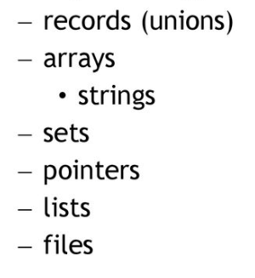
Composite Data Types

Slide 3
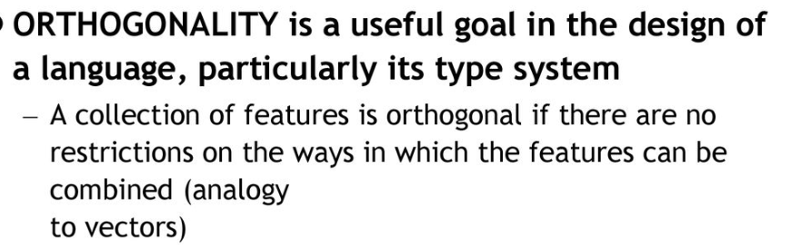
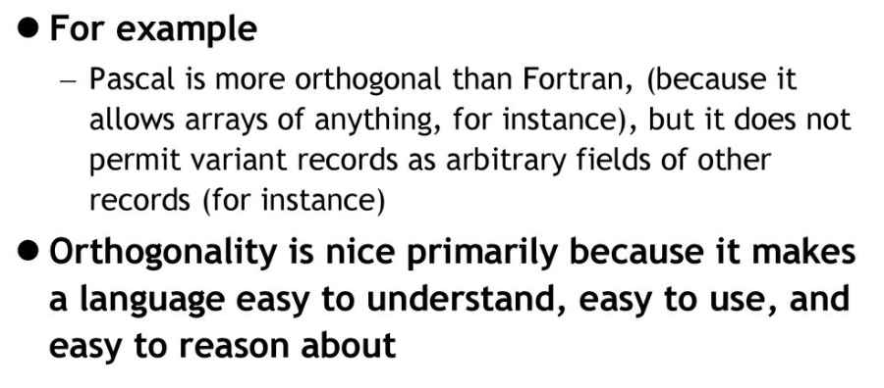
Orthogonality

Slide 4
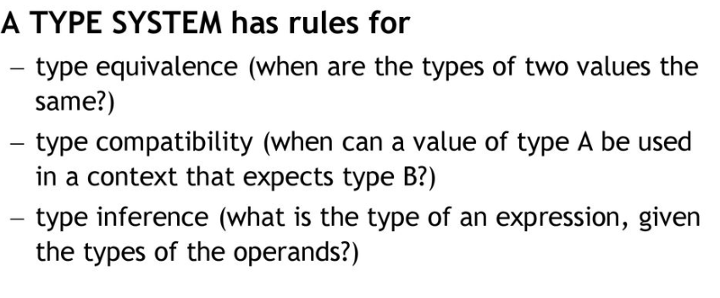
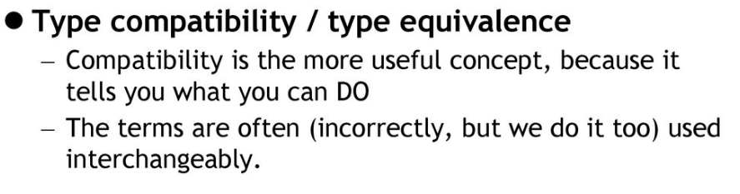
Type Checking

Slide 5
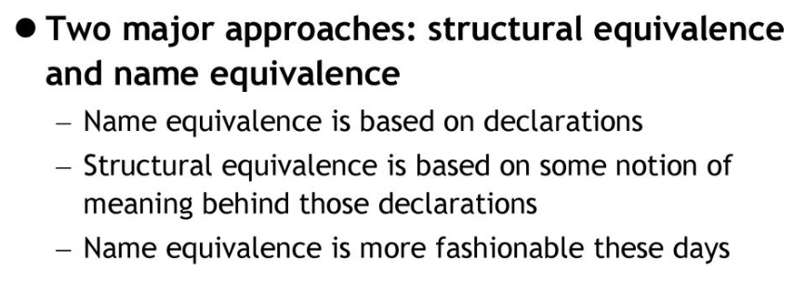
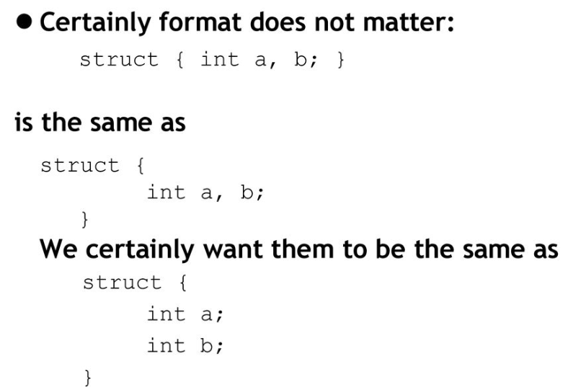
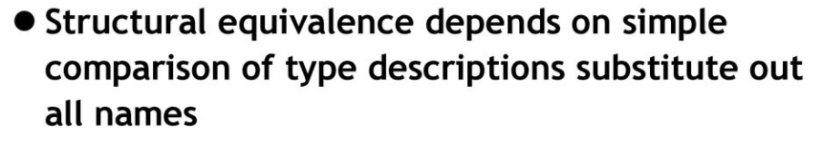
Type Checking

Slide 6
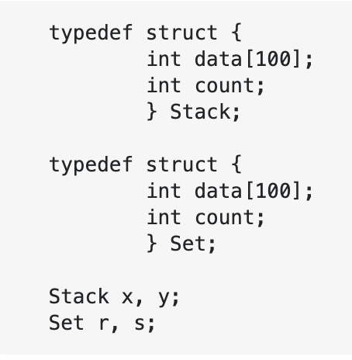
Name Equivalence and Structural Equivalence
x and y have name equivalence
r and s have name equivalence
x, y, r and s have structural equivalence.
Language which support only name equivalence, x = r is a wrong statement
Language which support structural equivalence, x = r is a right statement

Slide 7
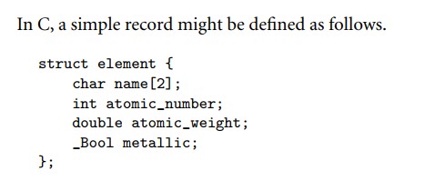
Records (Structures)
Record types allow related data of heterogeneous types to be stored and manipulated together.
Some languages (notably Algol 68, C, C++, and Common Lisp) use the term structure (declared with the keyword struct) instead of record.
Structures in C++ are defined as a special form of class (one in which members are globally visible by default).

Slide 8
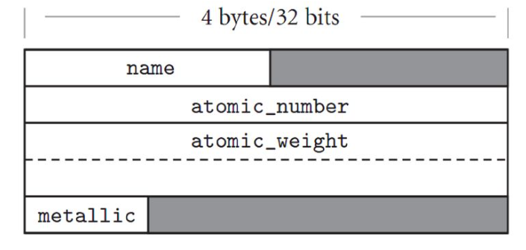
Memory Layout
Likely layout in memory for objects of type element on a 32-bit machine

Slide 9
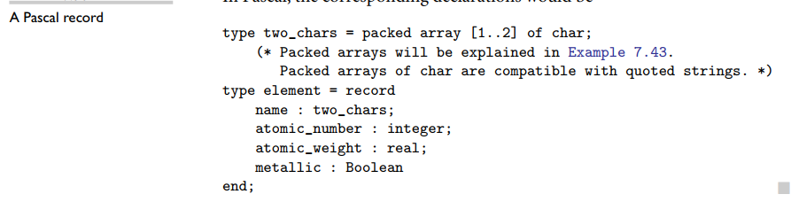
Record (Structure)
Packed Array : These arrays are bit-packed, i.e., each character or truth values are stored in consecutive bytes instead of using one storage unit

Slide 10
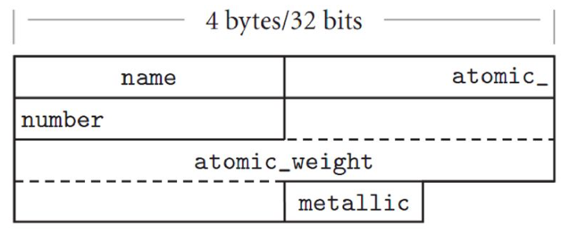
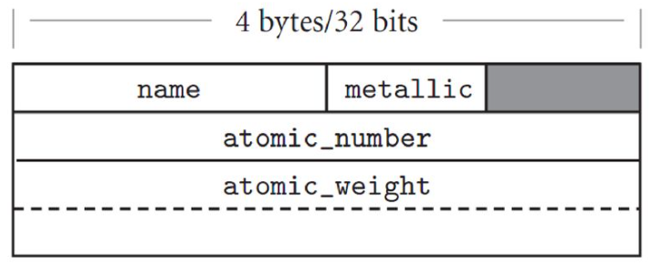
Memory Layout
Likely memory layout for packed element records
Packing minimizing holes by sorting fields
eliminates holes, but at potentially heavy cost in access time. A compromise, adopted by some compilers, is to sort a record’s fields according to the size of their alignment constraints. All byte-aligned fields might come first, followed by any half-word aligned fields, word-aligned fields, and (if the hardware requires) double-word–aligned fields.

Slide 11
Variants (Unions)
A variant or union is a type of structure that can be used where the amount of memory used is a key factor.
All of its members start at the same location in memory.
Similarly to the structure, the union can contain different types of data types.
This is most useful when the type of data being passed through functions is unknown, using a union which contains all possible data types can remedy this problem.
When the available memory is limited, it can be used to achieve memory efficiency.

Slide 12
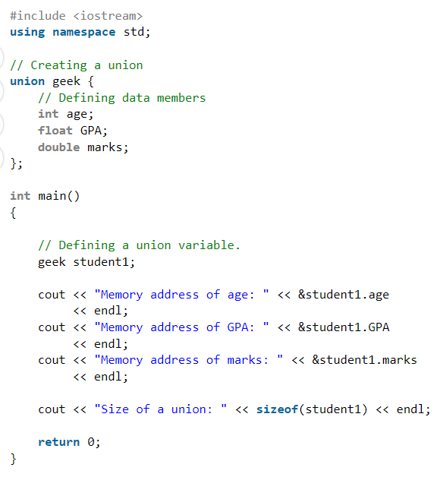
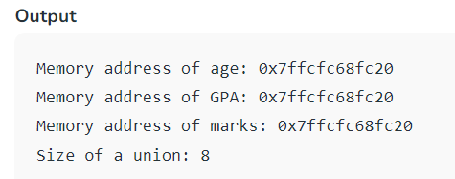
Variants/Unions

Slide 13
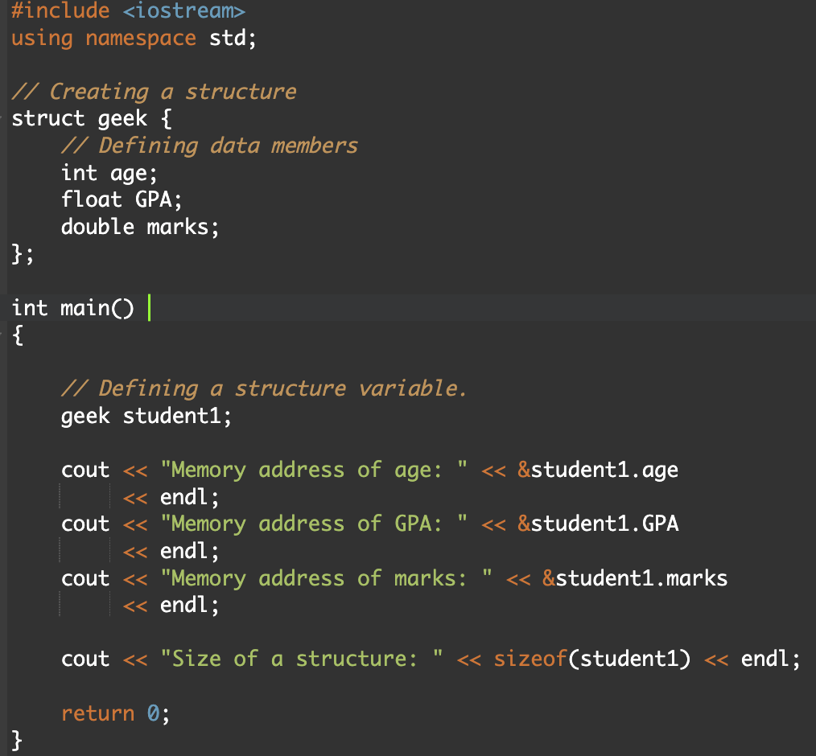
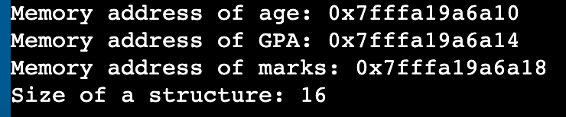
Record/Structure

Slide 14
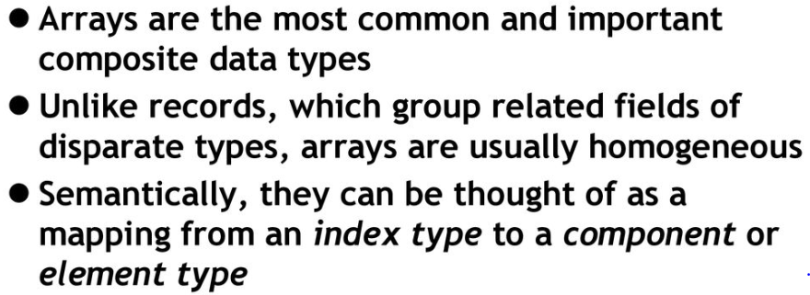
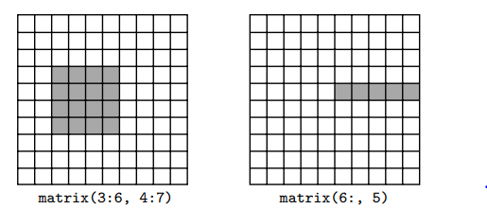
Array
Slice And Array Operation
Fortran 90 and Single Assignment C provide extensive facilities for slicing, as do many scripting languages, including Perl, Python, Ruby, and R

Slide 15
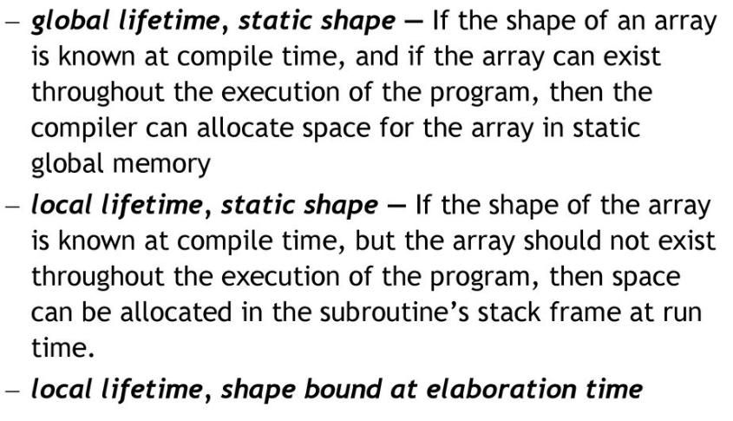
Dimensions, Bounds, and Allocation

Slide 16
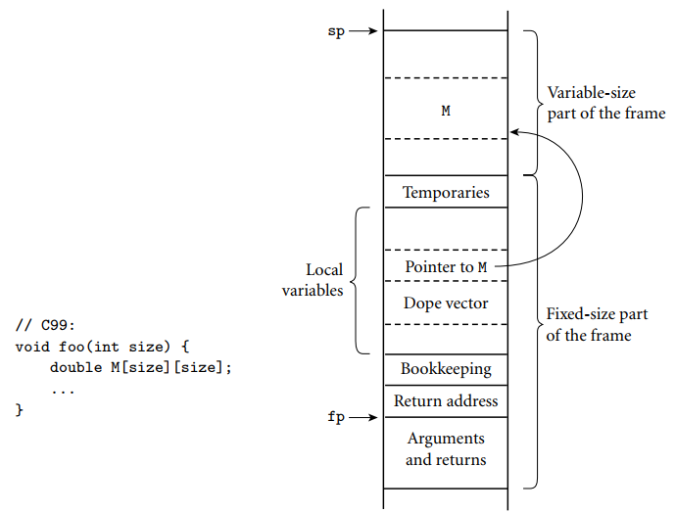
Allocation of arrays
M is a square two dimensional array whose bounds are determined by a parameter passed to foo at run time. The compiler arranges for a pointer to M and a dope vector to reside at static offsets from the frame pointer. M cannot be placed among the other local variables because it would prevent those higher in the frame from having static offsets. Additional variable-size arrays or records are easily accommodated.
Dope Vector : dope vector will contain the lower bound of each dimension and the size of each dimension

Slide 17
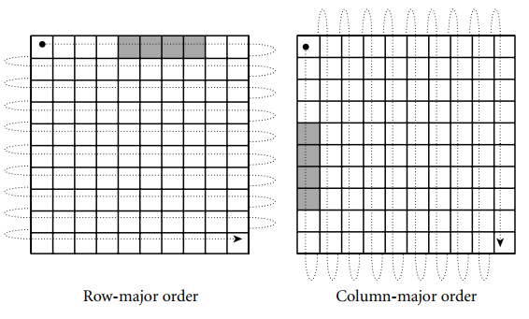
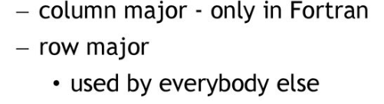
Row Major Vs Column Major
In row-major order, the elements of a row are contiguous in memory; in column-major order, the elements of a column are contiguous.

Slide 18
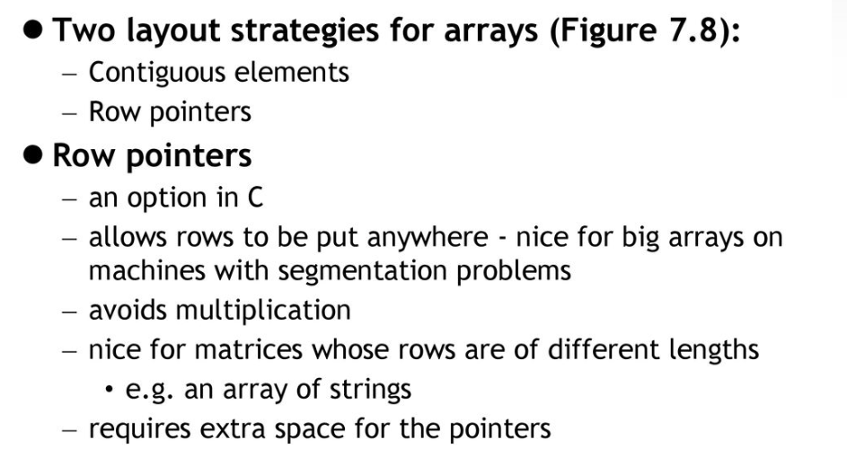
Memory Layout Strategy

Slide 19
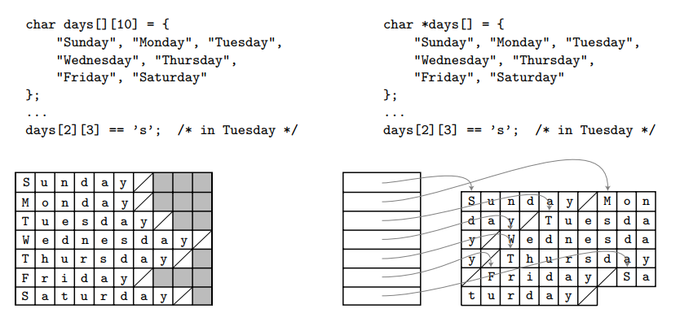
Contiguous array allocation vs row pointers in C
The declaration on the left is a true two-dimensional array. The slashed boxes are NULL bytes; the shaded areas are holes. The declaration on the right is a ragged array of pointers to arrays of characters. In both cases, we have omitted bounds in the declaration that can be deduced from the size of the initializer (aggregate). Both data structures permit individual characters to be accessed using double subscripts, but the memory layout (and corresponding address arithmetic) is quite different
Contiguous
Row Pointer

Slide 20
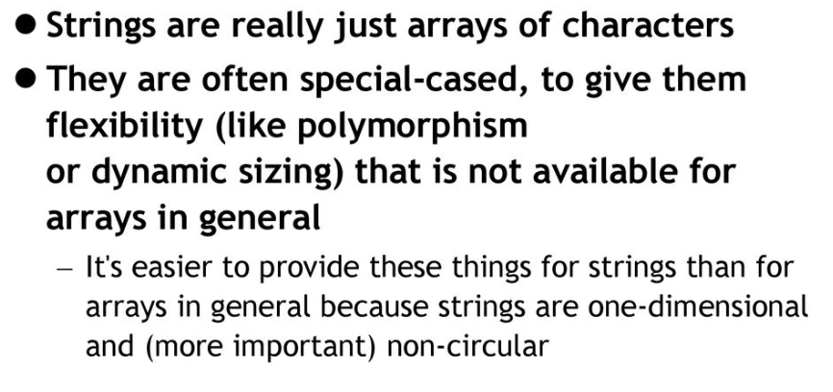
String

Slide 21
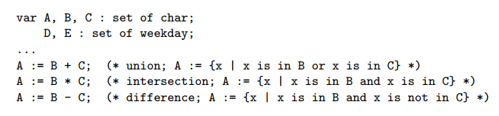
Sets
A programming language set is an unordered collection of an arbitrary number of distinct values of a common type.
Sets were introduced by Pascal, and are found in many more recent languages as well. The type from which elements of a set are drawn is known as the base or universe type.

Slide 22
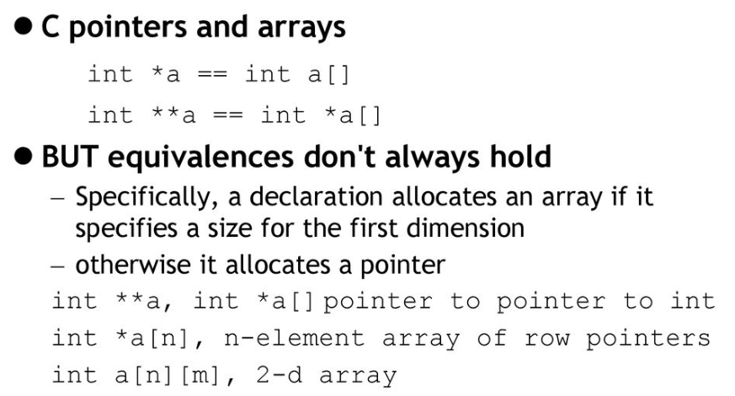
Pointers and Array

Slide 23
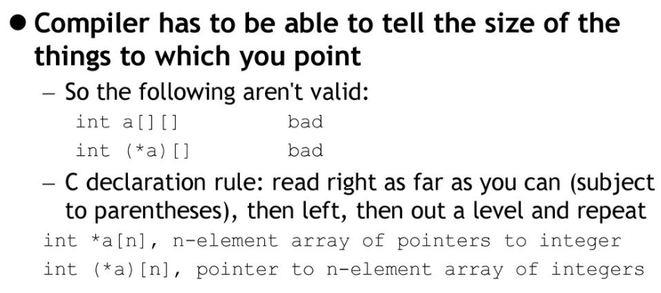
Pointers and Array

Slide 24
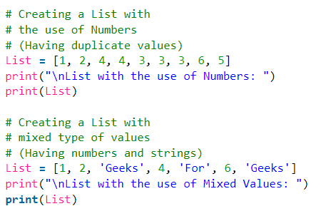
Lists
Example : Python list
Python Lists are just like dynamically sized arrays
In simple language, a list is a collection of things, enclosed in [ ] and separated by commas.
Lists need not be homogeneous always which makes it the most powerful tool in Python. A single list may contain DataTypes like Integers, Strings, as well as Objects. Lists are mutable, and hence, they can be altered even after their creation.

Slide 25
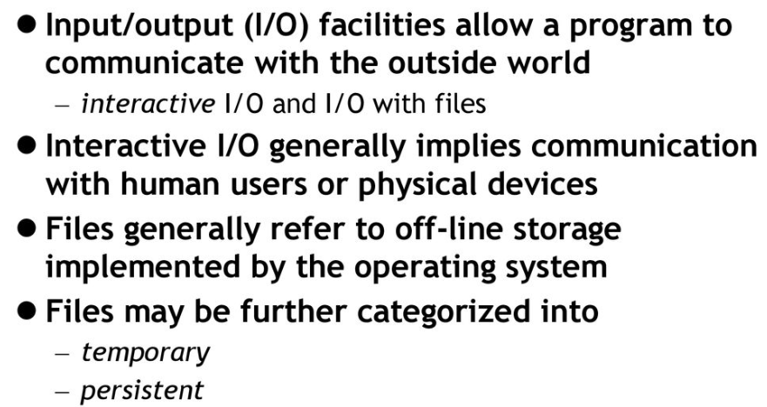
File I/O

